Slide 1
Correlation and Estimation of Two RVs
Term Project (individual)
Due: 2022. 06. 22

Slide 2
Generation of RVs
Generation of three random variables (X, Y1, Y2)
X: Gaussian, N(m_{x}=4, σ_{x}²=25)
2000 samples
Y1= aX +b + N_{z}(0, σ_{z}²=1) * exp{-(X-4)²/50} - (Eq.1)
a ≠ 0, b ≠ 0, set a and b as you want
First, generate X, and then generate Y1
Y2= aX +b + N_{z}(0, σ_{z}²=25) * exp{-(X-4)²/50} - (Eq.2)
set a and b same with of Y1
First, generate X, and then generate Y2

Slide 3
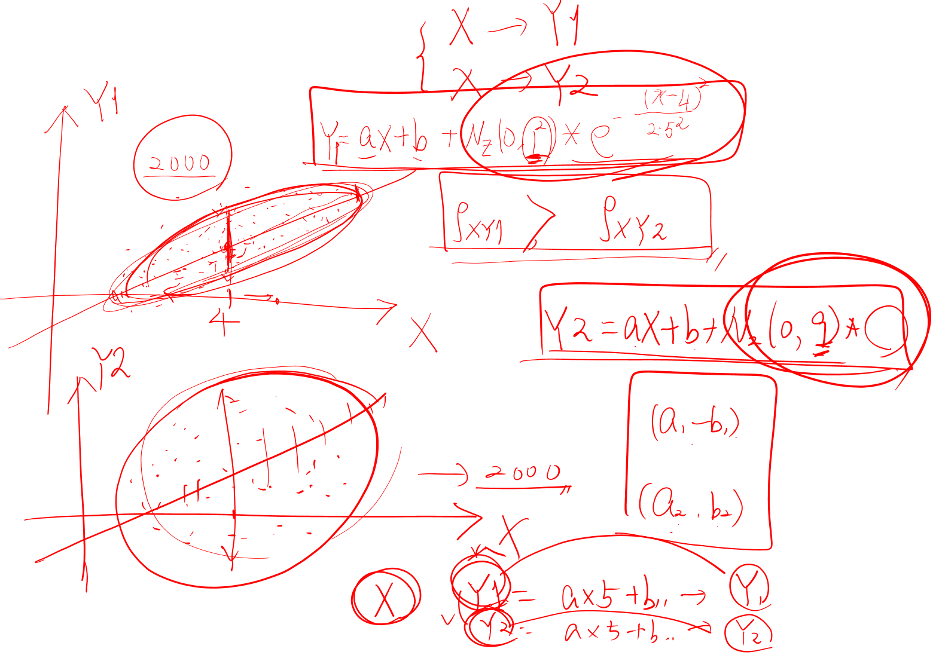
Generation of RVs

Slide 4
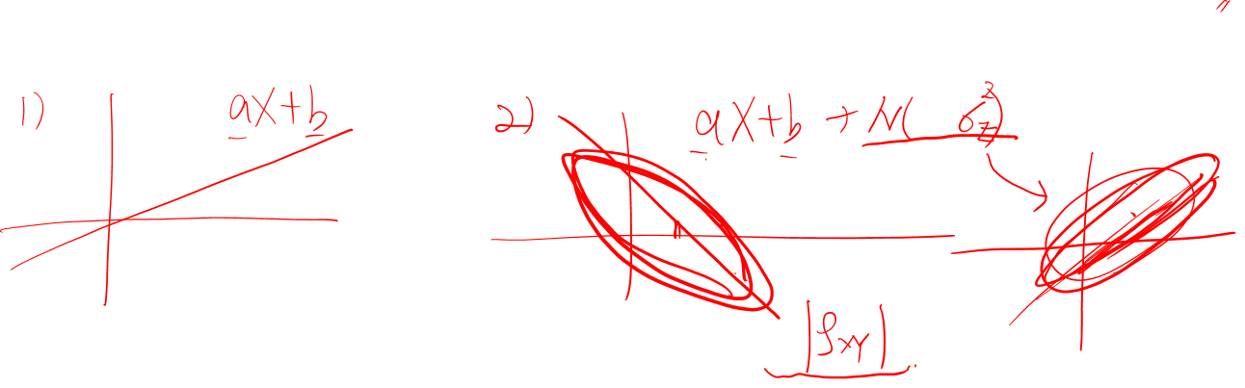
Finding Correlation
1) Finding correlation coefficients of X-Y1 and X-Y2
Compare and analyze the two correlation coefficients
2) Repeat another a and b
Same with σ_{z}² = 1 and σ_{z}² = 9
Compare and analyze the correlation coefficients with 1)
Analysis
What relation between correlation coefficients and noise variance (σ_{z}²) ?
What relation between line models (a,b) and correlation coefficients ?

Slide 5
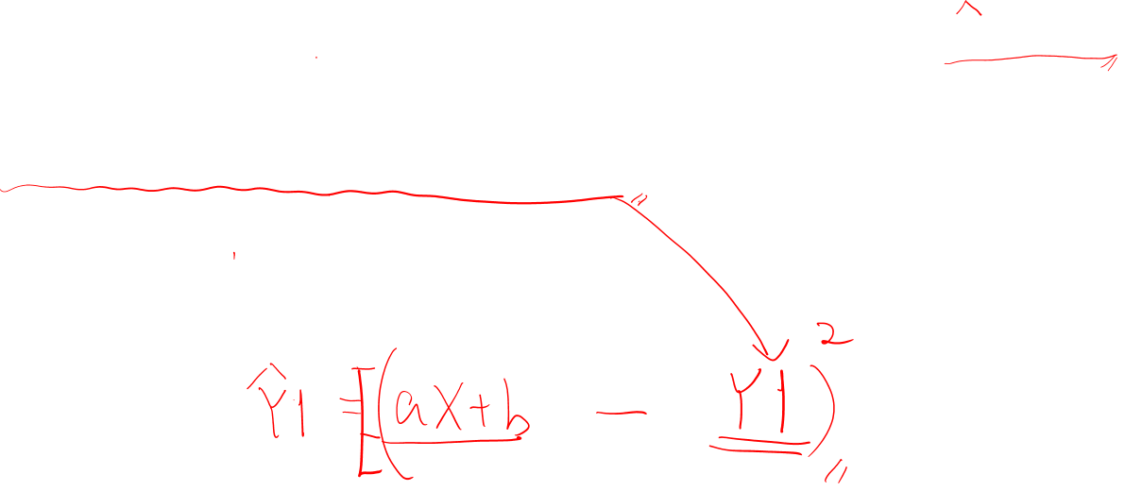
Estimation
Estimating Y1 when given an X for an (a, b)
1) First generate an X(200 samples), then calculate Y1 using Y1 = aX+b
2) Generate the Y1 using (Eq. 1) for the same X as in 1)
Y1= aX +b + N_{z}(0, σ_{z}²=1) * exp{-(X-4)²/50} - (Eq.1)
3) Calculate the mean squared difference between the estimated Y1 and generated Y1

Slide 6
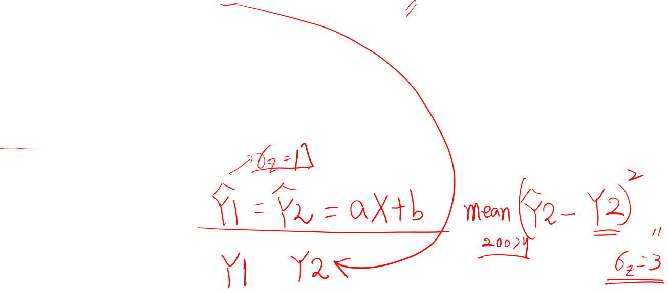
Estimation
Estimating Y2 when given an X for the same (a, b)
1) First generate an X (200 samples), then calculate Y2 using Y2 = aX+b
2) Generate the Y2 using (Eq. 2) for the same X as in 1)
Y2= aX +b + N_{z}(0, σ_{z}²=25) * exp{-(X-4)²/50} - (Eq. 2)
3) Calculate the mean squared difference between the estimated Y2 and generated Y2
Analysis
What relation between mean squared difference and noise variance (σ_{z}²) ?

Slide 7
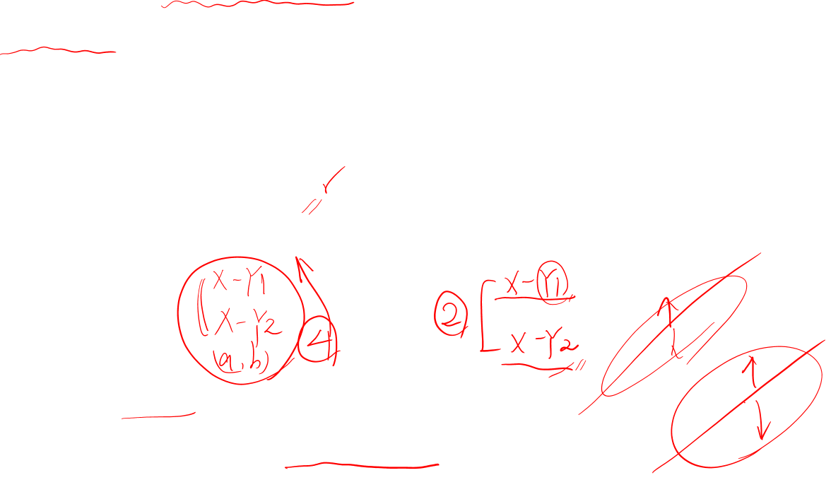
Report
Personal (one student) project
Write your report in ppt format (submission pdf file)
Maximum 20 pages including title
Report contents
Your own procedure and parameter values (a, b, ..)
Sample data plots (x-y 2D plane)
Results – correlation coefficients, mean squared errors of estimation
Analysis and discussion
Submission
Due: 2022. 06. 22 (Wed.) 13:00:00
Submit to LMS assignment link (16th week)

